Slide 1
Government Enforcers: Behind the Curtain Moderated By: William C. Pericak, Partner Katten Muchin Rosenman LLP
15th Annual
ABA Washington Health Law Summit
December 5, 2017

Slide 2
Panelists
Joseph Beemsterboer
Deputy Chief, Health Care Fraud Unit, Criminal Division, Fraud Section, DOJ
Natalie Priddy
Senior Counsel for Health Care Fraud, Civil Division, Fraud Section, DOJ
Lisa Re
Assistant Inspector General for Legal Affairs, Office of Inspector General, HHS
Disclaimer: This presentation was prepared by the moderator to facilitate discussion. The presentation does not necessarily reflect the views of the Department of Justice.

Slide 3
Overview
Key Areas of Investigative Focus
Impact of Coordinated Enforcement
Working with Whistleblowers
Tips for putting client in best position prior to and during an investigation

Slide 4
Overview of Agencies
DOJ Criminal
Fraud Section, Healthcare Fraud Unit
attorneys assigned to 9 strike force locations
Includes corporate strike force unit
DOJ Civil (affirmative litigation)
Commercial Litigation Branch, Fraud Section
~130 attorneys; approximately 2/3rd of the caseload is related to healthcare fraud
HHS OIG
Administrative & Civil Remedies Branch
~50 attorneys assigned to FCA cases nationwide, self-disclosures, CIA monitoring and OIG-initiated litigation

Slide 5
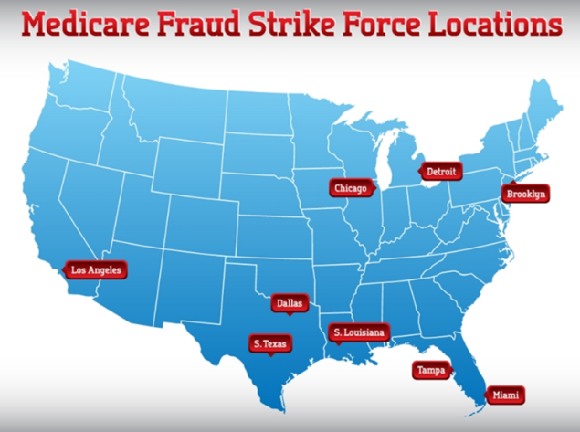
Medicare Fraud Strike Force

Slide 6
Civil Enforcement Efforts FY 2016
$2.5 billion recovered for health care fraud matters in FY 2016
More than $2 billion recovered for health care fraud matters each year since FY2010
Approximately 650-700 new qui tam matters filed each year, the majority related to health care

Slide 7
Sources of HCF Cases
Qui Tam False Claims Act complaints/relators
Data analysis
Self-disclosures by healthcare providers
HHS-OIG and FBI hotline complaints
Zone Program Integrity Contractor (ZPIC) referrals
Medicare Hotline complaints from beneficiaries
Referrals from law enforcement partners (e.g., HHS-OIG, FBI, FDA-OI, Medicaid Fraud Control Units, State AGs, DCIS, IRS, Postal OIG)
Cooperating defendants/witnesses

Slide 8
Proactive Investigations
Criminal Division, Corporate HCF Unit
The [Corporate HCF] unit is staffed by experienced health care fraud prosecutors, “who carefully review virtually every False Claims Act lawsuit filed by qui tam relators across the U.S.” “We now have over a dozen active corporate investigations, and we are steering additional prosecutorial resources to this area.”
AAG Caldwell, April 18, 2016
Obtain real time data from CMS to create/corroborate investigative leads, identify data outliers and strategic trends, and corroborate fraud tips.
AAG Caldwell, April 18, 2016
DOJ is “increasingly applying traditional investigative techniques. . . undercover officers, informants with body wires, bugs in offices, hidden cameras, GPS trackers and many other law enforcement tools—in . . . corporate health care fraud investigations.”
AAG Caldwell, May 14, 2015
Civil Division, Fraud Section
Relationship between DOJ attorneys and qui tam counsel

Slide 9
Key Areas of Investigative Focus
Fraud Schemes
Kickbacks to induce referrals
Upcoding
Claims for services that were unnecessary or not provided
Recent Areas of Focus
Opioids
Managed Care
Electronic Medical Records

Slide 10
Impact of Coordinated Enforcement
Criminal Fraud
Primary sanction - jail, asset seizures/freezes
Focus is on individuals and criminal entities
Civil Fraud
Treble damages and per claim penalties available under the False Claims Act
Can focus a broad range of corporate entities and individuals
HHS
Primary sanction – exclusion
Focus on future participation in federal health care programs

Slide 11
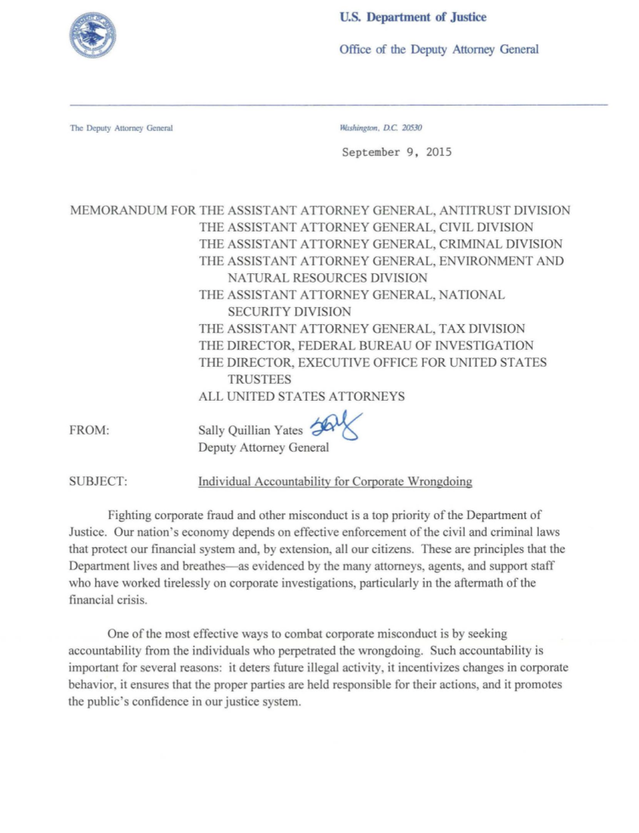
Individual Accountability
Guidance issued by DOJ’s Deputy General Sally Yates in Sept. 2015
Seeks consistency in “efforts to hold to account individuals responsible for illegal corporate conduct”
Establishes six steps intended to strengthen the pursuit of individual corporate wrongdoing

Slide 12
DOJ’s Policy re Individuals
“(1) in order to qualify for any cooperation credit, corporations must provide to the Department all relevant facts relating to the individuals responsible for the misconduct;”
“The guidance in this memo will also apply to civil corporate matters.”
Recent Examples
Indemnification Agreements

Slide 13
2017 HCF Takedown
41 Federal Districts
Law Enforcement Resources and Participation
Over 1,000 federal agents
30 state Medicaid Fraud Control Units (MFCUs)
Multi-day takedown resulted in charges involving:
115 medical professionals (up from 64 in 2016)
In total, 412 defendants (up from 301 in 2016)
particular focus on medical professionals involved in unlawful distribution of opioids and other prescription narcotics
HHS initiated exclusion actions against 295 providers, including doctors, nurses, pharmacists

Slide 14
Other Examples
“Cases involving fraud by executives at health care providers such as hospitals are also a high priority for us”
AAG Leslie R. Caldwell, Sept. 17, 2014
Riverside Hospital
catalyst - aberrant real time data trends
body wire used to record hospital administrator discussing kickback payments; search warrants executed
Tenet Hospital
catalyst – qui tam complaint
Government agents confronted hospital administrator and kickback payee; both decided to plead guilty and cooperate
Hospital Administrator indicted

Slide 15
Section 1128(b)(7) Risk Spectrum OIG Revised Exclusion Criteria

Slide 16
CMP recoveries, CIAs and exclusions resulting from fraud settlements
Negotiated CIAs and Exclusions

Slide 17
OIG CMP Recoveries

Slide 18
OIG Self-Disclosures Average Time in Protocol

